Slide 1
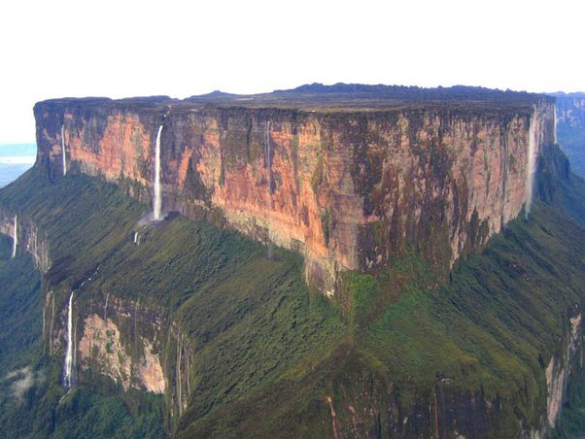
My Project Age of Geeona
The Adventure Through Geeona
By James Alexander David Hayward

Slide 2
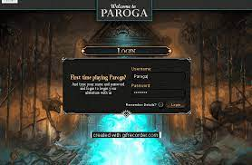
Log in Screen?
WELCOME TO GEEONA
Would like to implement
Will only start the timer when logged in

Slide 3
Game Basics
The game will take you on a journey through the lands of Geeona, answering questions and making decisions to face the boss at the volcano

Slide 4
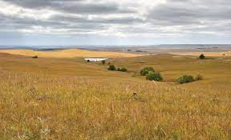
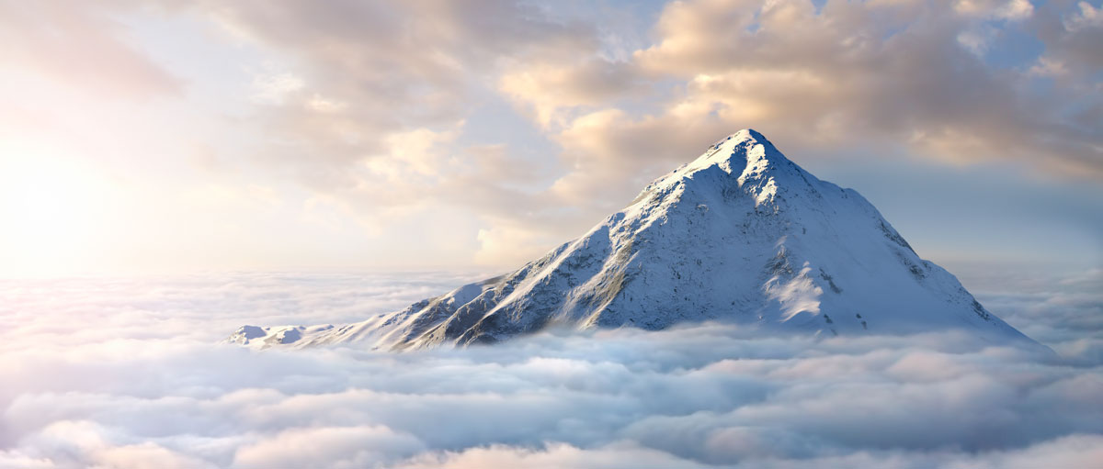
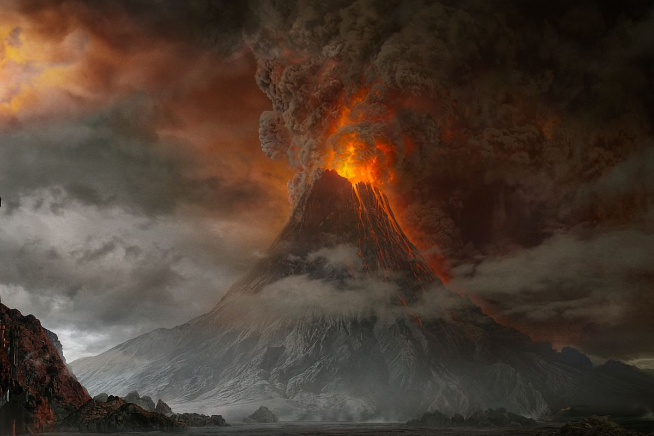
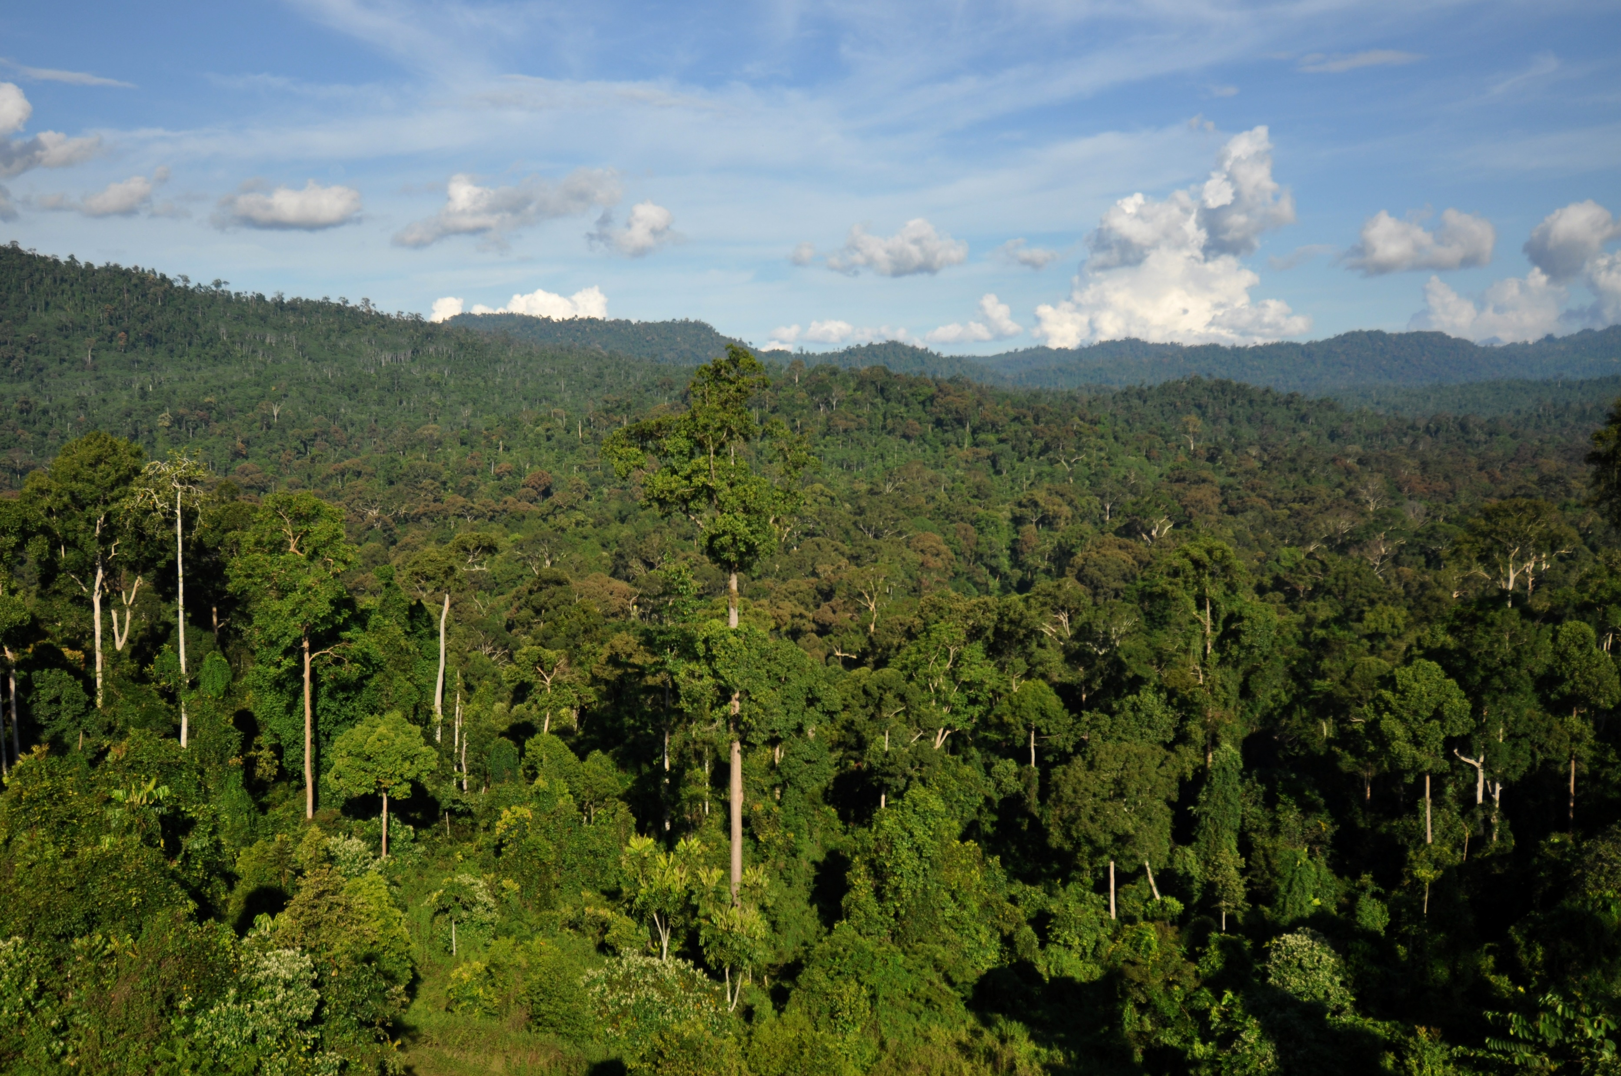
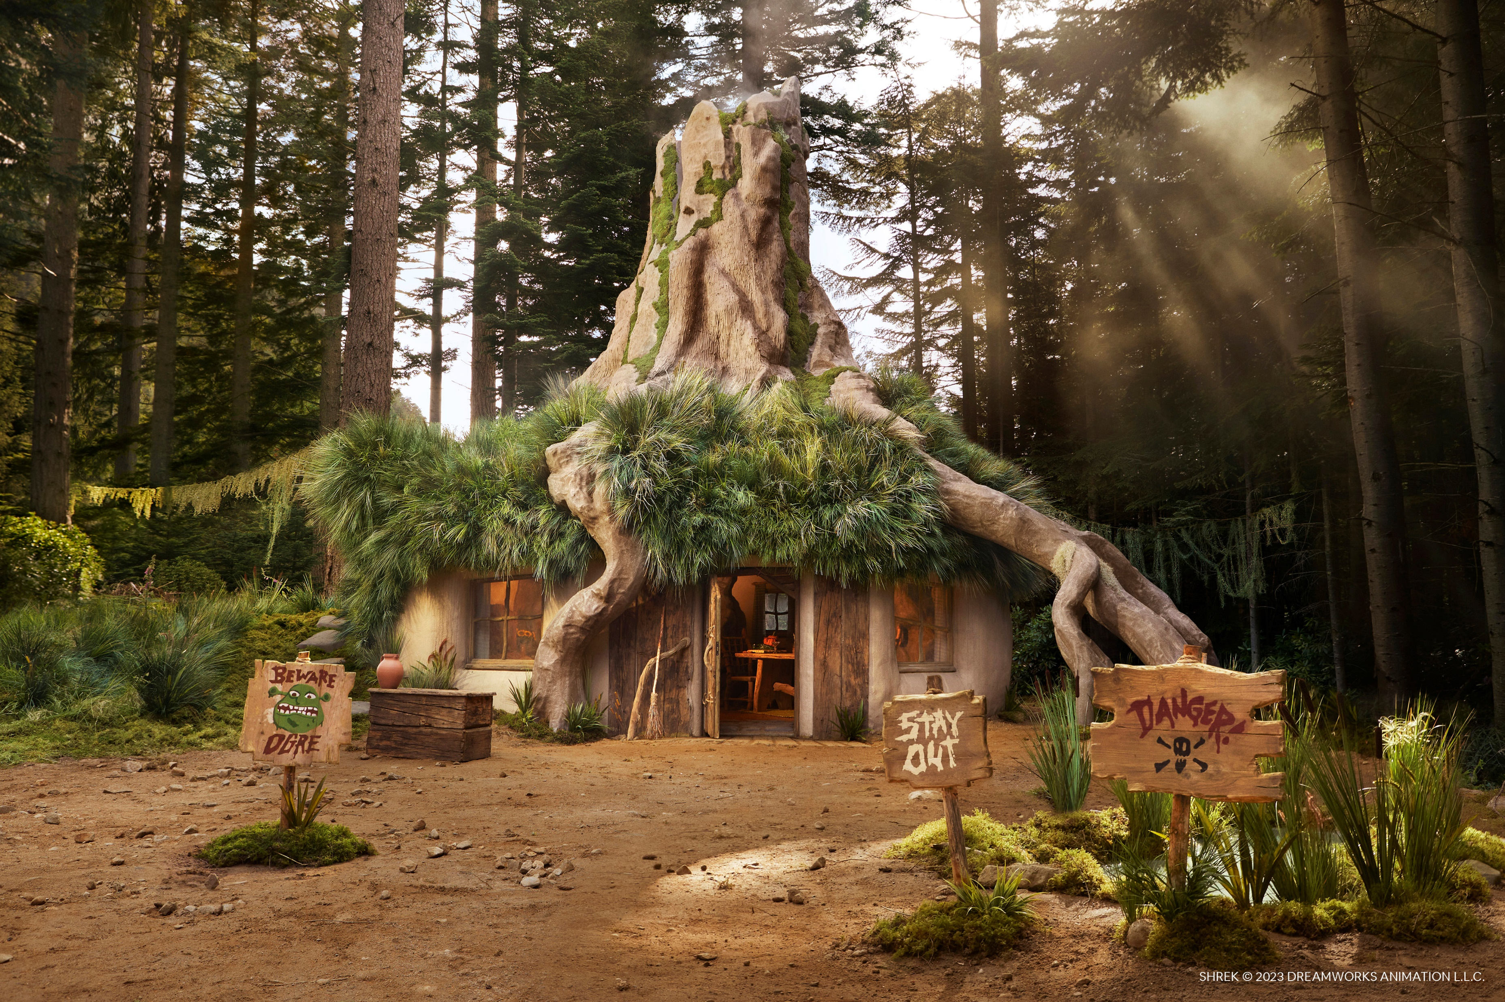
5 Areas
Plains
Mountain
Forest
Swamp
Volcano

Slide 6
Plains
The first level

Slide 8


Slide 9


Slide 11
Volcano
This is where you will face the final boss answering a series of riddles to defeat him
Clues will be given throughout the other 4 levels to help you complete these riddles, although these are not required they will help

